Slide 1
General Problems with the production of foreign recombinant protein expressed in E.coli
Problems caused by the sequence of the foreign gene
Problems caused by the E.coli

Slide 2
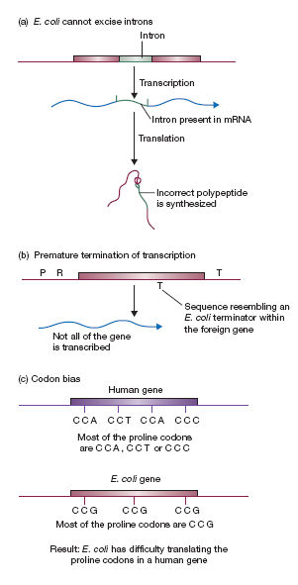
General Problems with foreign protein expressed in E.coli

Slide 3
Problems caused by E.coli
E.coli NOT always the best organism
E. coli might not process the recombinant protein correctly (post translational modifications)
Correct disulfide bond formation
Proteolytic cleavage of inactive precursor
Glycosylation - addition of sugar residues
Alteration of amino acids in protein
phosphorylation
acetylation
sulfation
fatty acid addition
E. coli might not fold the recombinant protein correctly (S-S bonds, incorrect folding, inclusion bodies, inactive)-Use chaperone overexpressing strains
E. coli might degrade the foreign recombinant protein- Use protease deficient strains

Slide 4
Eukaryotic Expression Systems
Saccharomyces cerevisiae
Pichia pastoris
Mammalian systems
Transient expression:
Vero cells are derived from the kidney of an African green monkey, and are one of the more commonly used mammalian continuous cell lines in microbiology, and molecular and cell biology research
BHK (Baby hamster kidney) cells line- like BHK-21 is one of the most commonly used cell lines for the expression of biopharmaceuticals, and it is also among the top three cell types that have been most frequently used for transient expression. BHK cells are originally isolated by polyoma transformation of hamster cells and have been extensively used as substrates for virus propagation for vaccine and more generally for viral mediated expression
Human Embryonic Kidney Cell line- HEK293 cells
Long-term expression: Chinese hamster ovary and mouse myeloma cells.
Notes:
HEK293 cells are Human Embryonic Kidney cells, originally isolated and grown by Dutch biologist Alex Van der Eb in the early 1970s. They were transfected with sheared adenovirus 5 (Ad5) DNA by Frank Graham, a postdoc in Van der Eb’s lab. It was his 293rd experiment, which is why they got the tag HEK293 (read the original paper here).
Incorporating the adenoviral genes into the HEK cell genome resulted in the cells becoming very efficient at producing high amounts of recombinant proteins from plasmid vectors carrying the CMV promoter region.
So, are HEK293T cells the same thing? Not exactly. The ‘T’ in the name of this daughter cell line comes from the incorporation of the SV40 large T antigen into the HEK293 genome – this means they are able to produce large amounts of protein from plasmids vectors carrying the SV40 origin of replication. There are other HEK293 derivatives, but that’s a whole other article!
What’s so Great About HEK Cells?
There are many advantages of using HEK293 cells. They are a hardy, semi-adherent, low-maintenance cell line and divide rapidly, doubling about every 36 hours. They can be utilized for both transient and stable expression, can be cultured in suspension or as a monolayer, are easy to transfect (and can be transfected via a variety of methods) and are able to produce large amounts of recombinant proteins. Because of their advantages and versatility, they are the second most widely used cell line after HeLa, the first ever human cell line. HEK293 cells are used in cancer research, vaccine development, protein production, signal transduction and protein interaction studies, drug testing etc

Slide 5
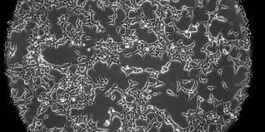
HEK293 Cells
HEK293 cells are Human Embryonic Kidney cells, originally isolated and grown by Dutch biologist Alex Van der Eb in the early 1970s. They were transfected with sheared adenovirus 5 (Ad5) DNA by Frank Graham, a postdoc in Van der Eb’s lab. It was his 293rd experiment, which is why they got the tag HEK293 A 4-kb Ad5 DNA fragment encoding the E1A/E1B proteins was later shown to have integrated into chromosome 19, resulting in transformation.
Incorporating the adenoviral genes into the HEK cell genome resulted in the cells becoming very efficient at producing high amounts of recombinant proteins from plasmid vectors carrying the CMV promoter region.
There are many advantages of using HEK293 cells. They are a hardy, semi-adherent, low-maintenance cell line and divide rapidly, doubling about every 36 hours. They can be utilized for both transient and stable expression, can be cultured in suspension or as a monolayer, are easy to transfect (and can be transfected via a variety of methods) and are able to produce large amounts of recombinant proteins. HEK293 cells are used in cancer research, vaccine development, protein production, signal transduction and protein interaction studies, drug testing etc
Notes:
https://www.synthego.com/hek293- more details on HEK293

Slide 6
HEK293T
The ‘T’ in the name of this daughter cell line comes from the incorporation of the SV40 large T antigen into the HEK293 genome – this means they are able to produce large amounts of protein from plasmids vectors carrying the SV40 origin of replication.

Slide 7
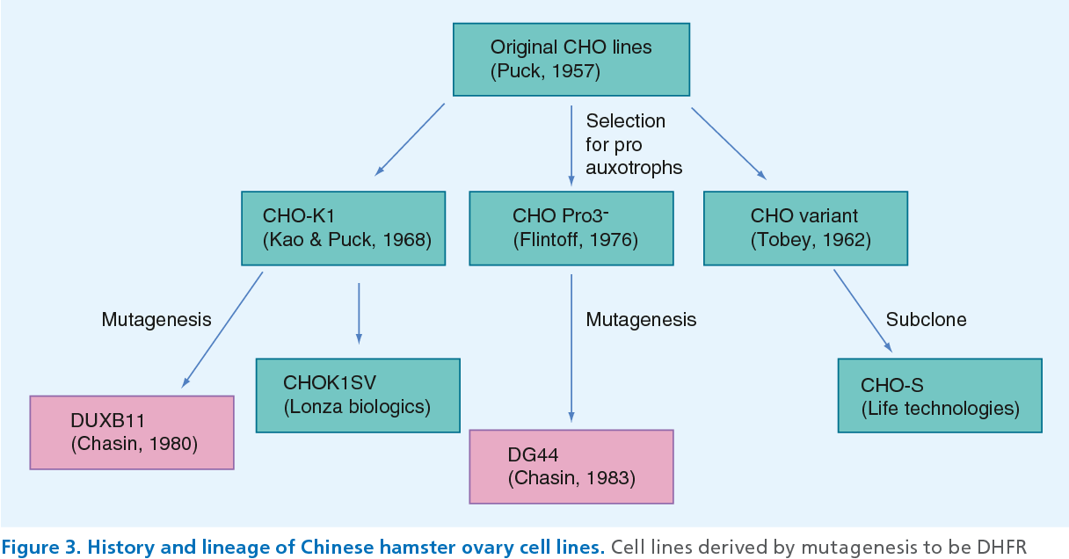
CHO Cell lines
DUXB11 and DH44- A cell line deficient in DHFR activity, which requires the addition of glycine, hypoxanthine, and thymidine (GHT) in the medium for survival, allows for the implementation of a selection system based on the insertion of a cloned dhfr gene in combination with the gene of interest.
Notes:
https://www.ncbi.nlm.nih.gov/pmc/articles/PMC3718848/
The most common mammalian cell line used in biologic production processes is the Chinese hamster ovary (CHO) cell line, which was isolated from the Chinese hamster in the 1950s (Tjio and Puck, 1958). In the early 1980s, under the direction of Dr. Chasin at Columbia University, two derivatives of the CHO cell line, CHO-K1 and CHO pro-3, gave rise to the two most commonly used cell lines in bioprocessing today, DUKX-X11 and DG44. Both cell lines were engineered to be deficient in dihydrofolate reductase (DHFR) activity: chemical mutagenesis was used in DUKX-X11 to delete one DHFR allele and mutate the other, and ionizing radiation was used in DG44 to delete both alleles (Lee et al., 2010; Wurm and Hacker, 2011). A cell line deficient in DHFR activity, which requires the addition of glycine, hypoxanthine, and thymidine (GHT) in the medium for survival, allows for the implementation of a selection system based on the insertion of a cloned dhfr gene in combination with the gene of interest. When grown in GHT deficient media, only the cells containing the recombinant vector can survive and produce the protein of interest. It is not surprising that CHO cells were used to produce tPA in 1987 and are still the most commonly used host today because, over the past 25 years, research has focused on manipulating established host cell lines, not on searching for a better host system.
A clonal isolate, derived from Chinese hamster ovary (CHO K1) cells. The CHO-S parental cell line was selected for growth and transfection efficiency. CHO-S cells are adapted to serum-free suspension culture

Slide 8
Eukaryotic Expression Vectors
Same sorts of genetic features
eukaryotic promoter-generally derived from animal viruses or from highly expressed mammalian genes (SV40, cytomegalovirus (CMV), herpes simplex virus (HSV), Elongation factor 1 (EF1)
ori of replication (eukaryote..usually viral, SV40)
selectable marker (for eukaryotic cell)
mRNA polyadenylation signal
ori of replication (Plasmid)
selectable marker (bacteria)
https://www.synbio-tech.com/mammalian-cell-expression-vectors/

Slide 9
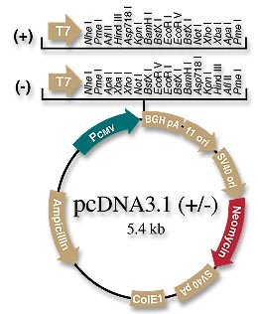
Notes:
https://blog.addgene.org/plasmids-101-mammalian-vectors

Slide 10
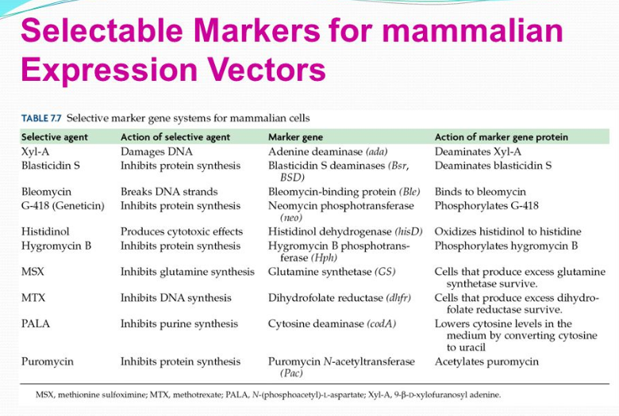
https://www.synbio-tech.com/mammalian-cell-expression-vectors/
Notes:
https://www.synbio-tech.com/mammalian-cell-expression-vectors/

Slide 11
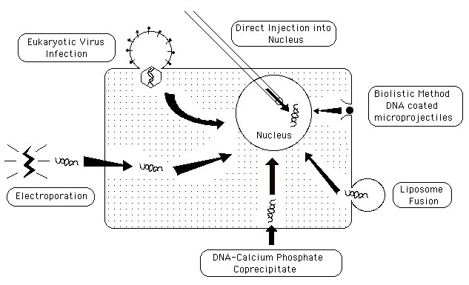
Transfection Methods
Notes:
Refer https://en.wikipedia.org/wiki/Vectors_in_gene_therapy

Slide 12
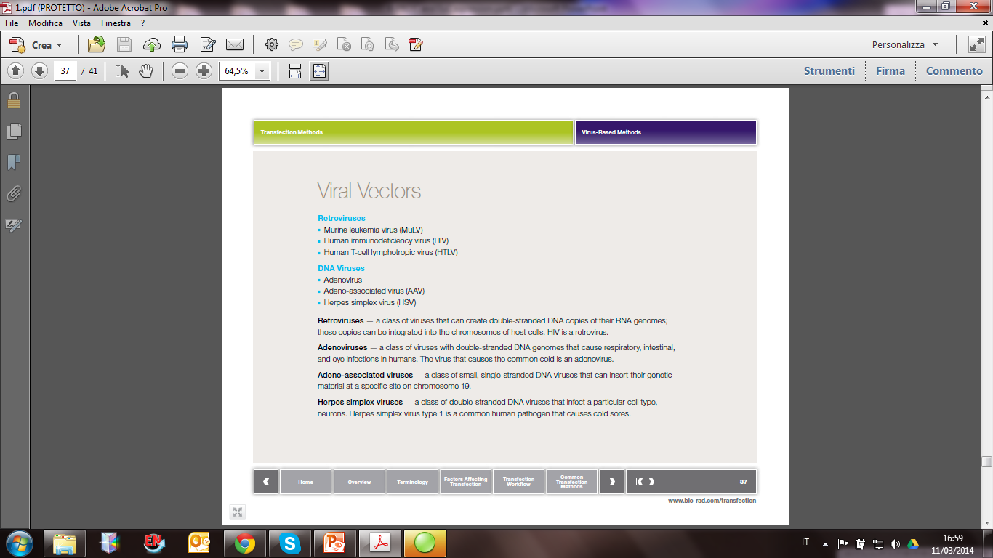

Slide 13
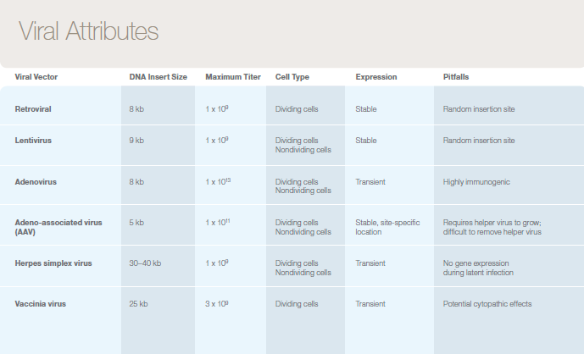
Notes:
• Adenoviruses:
• Enable large fragment of DNA to be cloned than SV40
• More difficult to handle because genomes are bigger
• Retroviruses
• At present, most commonly used vector in mammalian cells
• Most important application: gene therapy

Slide 14
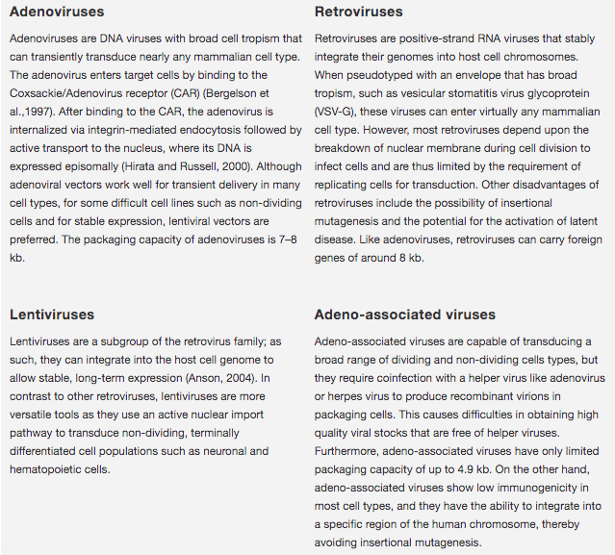
Notes:
Source thermofisher website

Slide 15
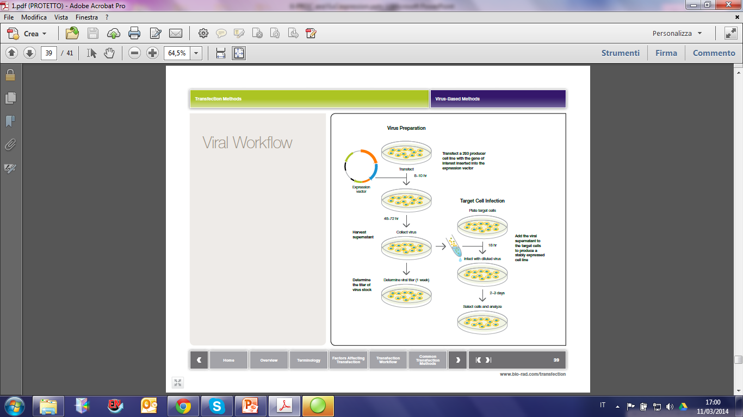

Slide 16
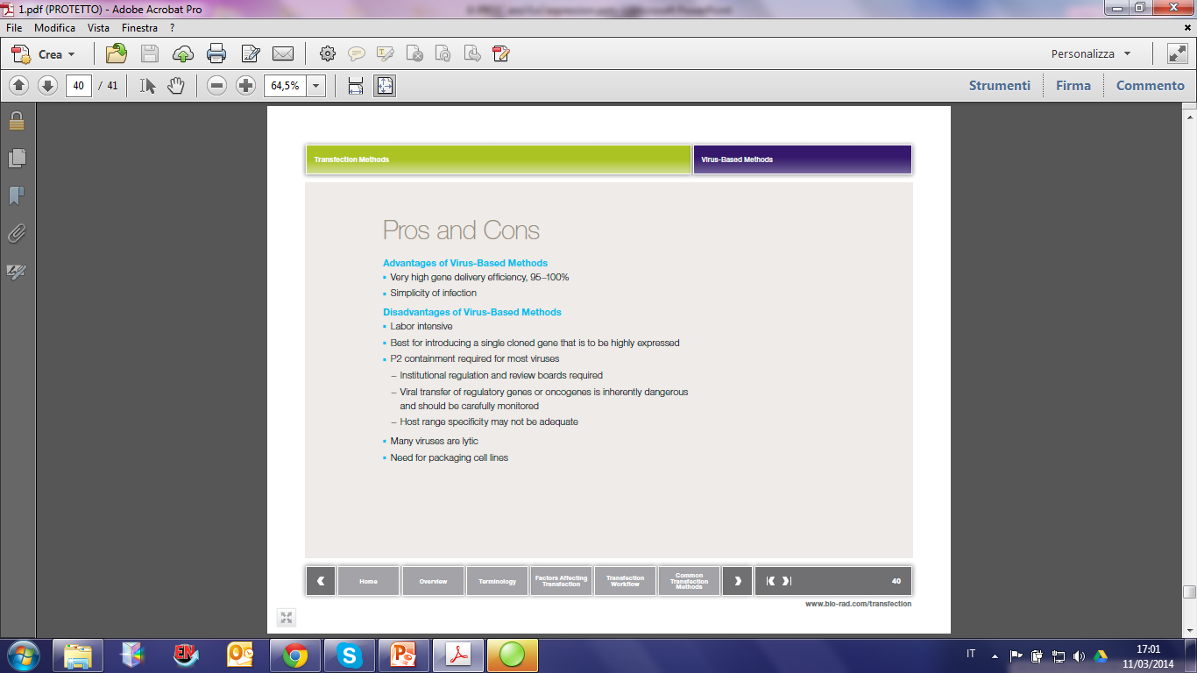

Slide 17
Protein Drugs Produced by Eukaryotic Cell Culture
Protein Condition
Factor IX & VIIIc hemophiliacs
CD4 receptor AIDS
erythropoetin cancer
β & γ interferons cancer
Interleukin-2 cancer
tissue plasminogen activator heart attack/stroke
Hepatitis B surface antigen vaccine
monoclonal antibodies various

Slide 18
